Slide 1
Sugon 8-way Server
—I980-G10

Slide 2
Contents
1
Process and positioning of the product
2
Overview and features of the product
3
RAS and reliability of the product
4
Ecosystem and solution
Notes:
先讲整个IT行业的大背景

Slide 3
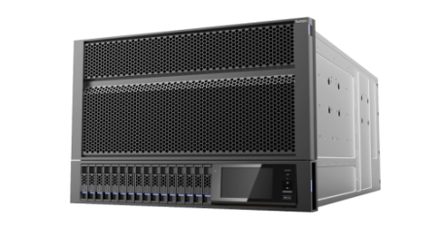
Sugon:
the first manufacturer to develop 8-way server independently over 10 years
Leading the independent development of 8-way system made in China
Start to independently develop the first 8-way server made in China
2003
2005
With China’s first first 8-way server A950r-F in mass production， Sugon became the first manufacturer having mass production ability of 8-way system in China
2010
The annual sales of A950r-F were over 1000
2010
Sugon’s second generation of 8-way server system-- I950r-G was issued.
Sugon’s third generationof 8-way server system--I980-G10 was issued.
2014
Notes:
先讲整个IT行业的大背景

Slide 4
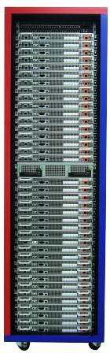
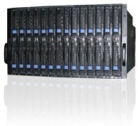
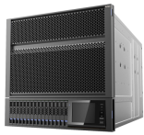

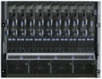


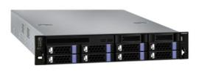


High
performance
Position of Sugon server X86
Scale up system replaces traditional minicomputers and critical business required high reliability;
Database application, Business Intelligence(ERP) and massive virtualization
It is for medium to large scale clients such as telecommunication, finance, securities, electricity and government department .
Scale out system is for servers consolidation and regular use in SMB market；
issued TTM, concentrated products and the way of trade promoting industry low cost.
The latest technology architecture and energy-saving;
Scale out system is for servers consolidation and regular use in SMB market；
issued TTM, concentrated products and the way of trade promoting industry low cost.
The latest technology architecture and energy-saving;
TC4600
I980
I950
I620/A620
EP440
I840
TC3600
TC5600
I420/A420
I650/A650
A840
I410/A410
A440
High extensibility
tower-type
rack and 2-way
4-way
8-way
Blade Server
high density
Notes:
先讲整个IT行业的大背景

Slide 5
Contents
1
Process and positioning of the product
2
Overview and features of the product
3
RAS and reliability of the product
4
Ecosystem and solution
Notes:
先讲整个IT行业的大背景

Slide 6
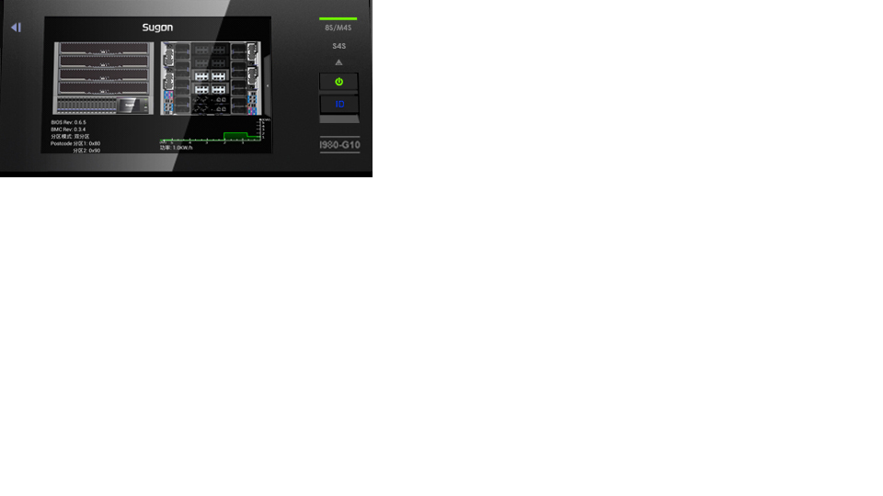
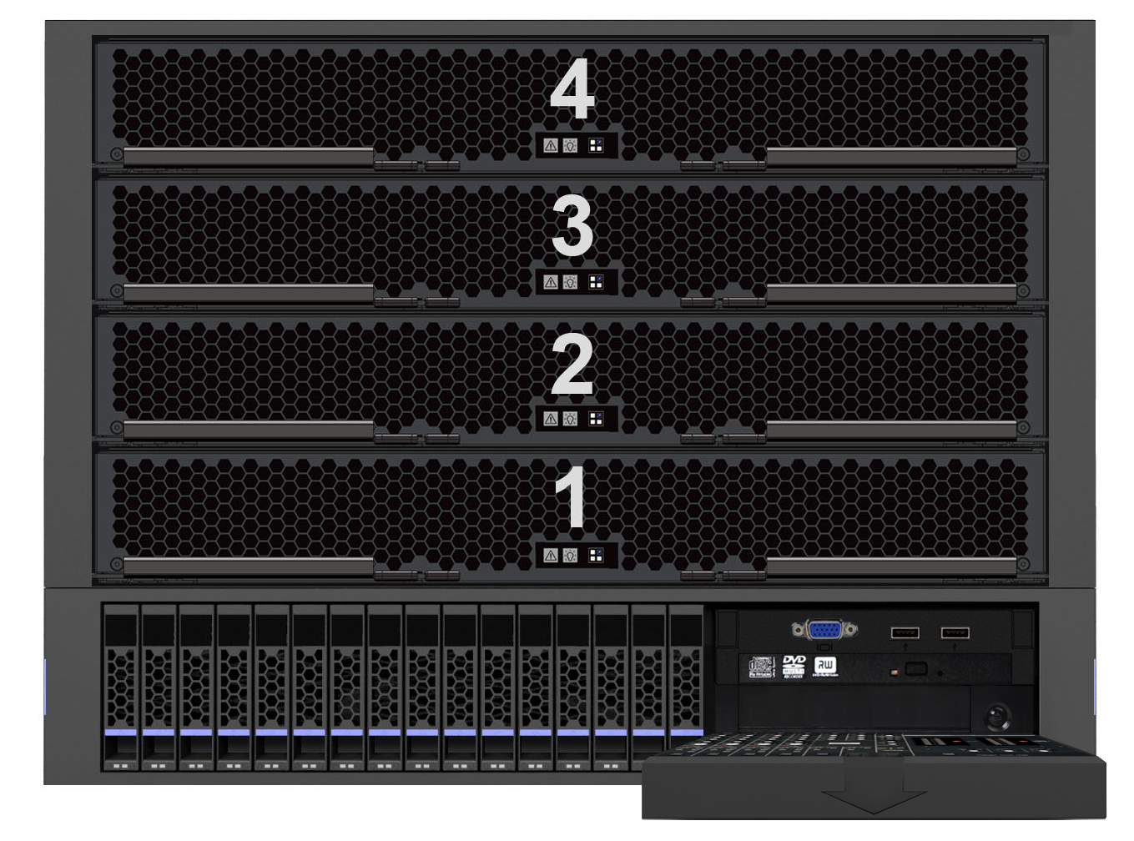
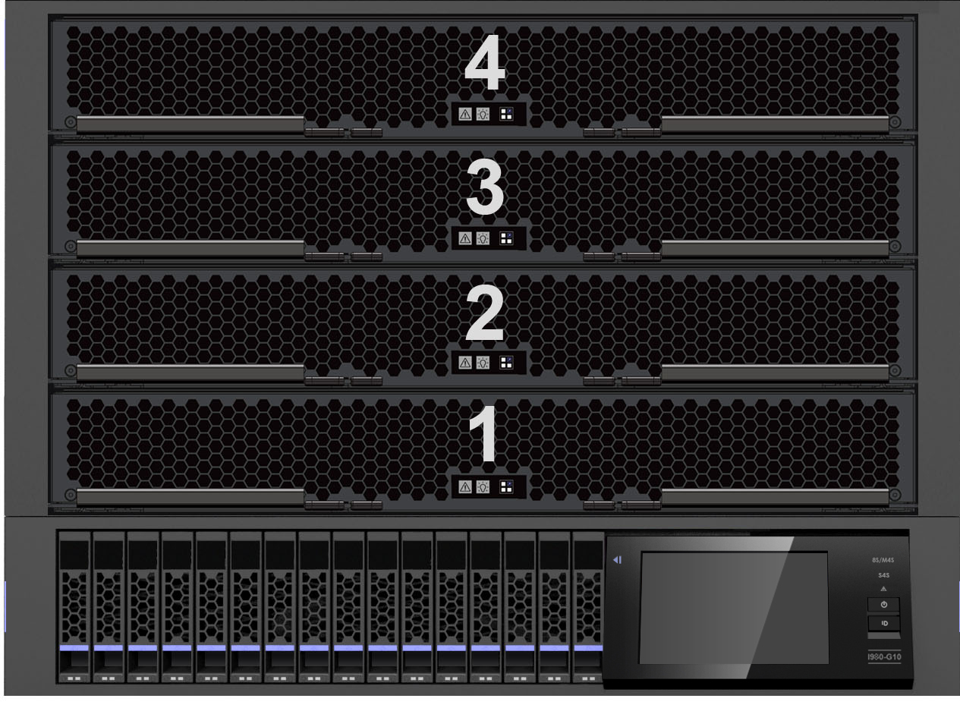
I980-G10 Front Panel
Board module
[1、3] for a group
[2、4] for a group
VGA interface
USB interface
DVD drive
tape machine(optional）
Disk module(max) :16 2.5’diskc
Touch Screen Monitoring
Notes:
先讲整个IT行业的大背景

Slide 7
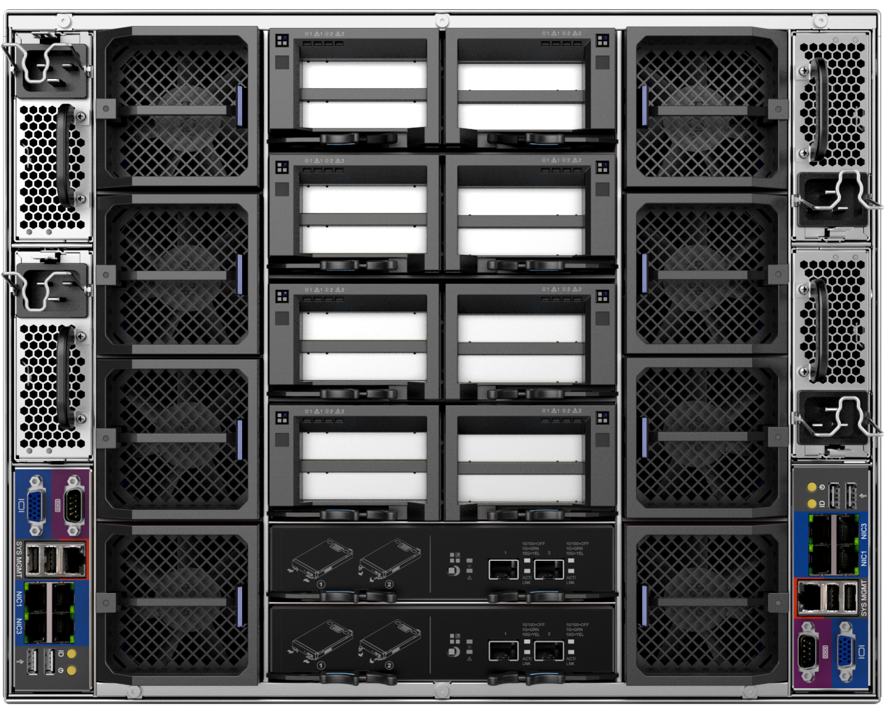
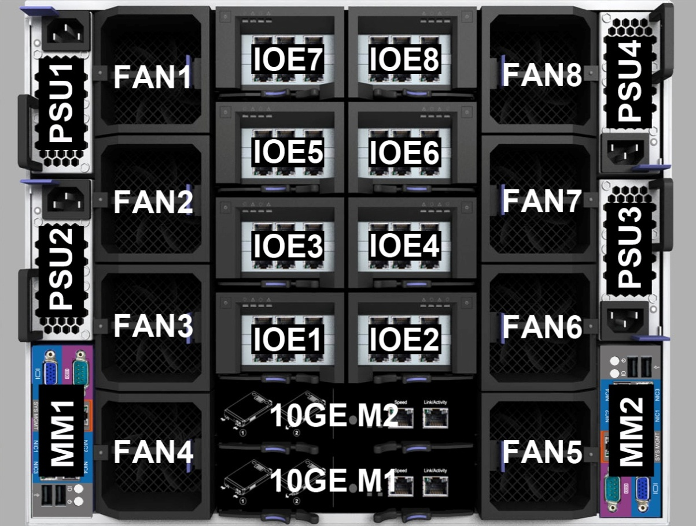
I980-G10 Back Panel
Hot-swappable IOE Module；
Support 16* X8 /4* X16 PCI-E Cards，
Support GPU；
Power Module:
4* 2000W(max)；
2+1, 3+1, 2+2 Redundant Mode
Up to 8 hot swap redundant fans
4* USB 2.0
Management
VGA Serial Port, 4* GbE/hundred Mbps interface
4个USB interface
Dual ports 10 GbE SFP
Optional number:0/1/2
Notes:
先讲整个IT行业的大背景

Slide 8
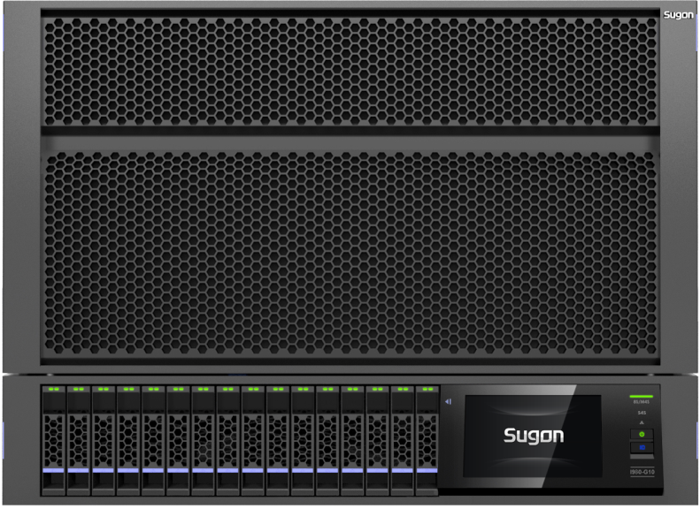
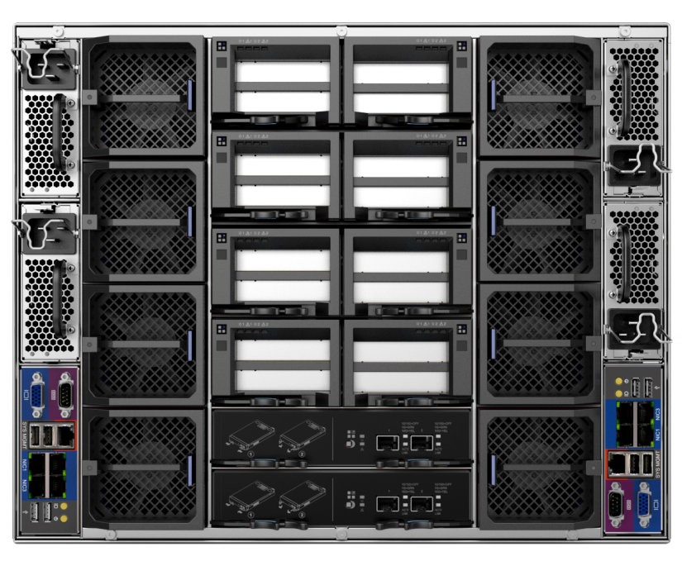
Technical specifications of I980-G10
 | I980-G10
Rake | 8U
Processor | Maximum 8 Intel E7-8800/4800 V2 series of processor can be supported
Chipset | Intel C602J
Memory | Support 128个DIMM slots ，and 8TB ,RDIMMs, DDR3L, LR-DIMM (max)
I/O Expansion | Support 16 PCI-E3.0x8 slots or 4 PCI-E3.0 x16 slots (support GPU、PHY) Support 4 PCI-E3.0 x16 expansive slots(max)； All of IO slots and modules support hot plug
Storage | Maximum 16 2.5 “SAS/ SATA disks and RAID 0,1,5,6 can be supported 2 mSATA disks are optional and supporting RAID0,1 2 One SATA DOM is optional for memory
Network | Integrated Intel I350 4-port Gigabit network card Ten-gigabit network module expansion is optional
Management | Support IPMI 2.0 and rKVM; provide WEB management interface and touch intelligent screen for monitoring
Power supply | Support 4 power supply modules (maximum), each module is 2000W, champion conversion efficiency:92%; redundant N+N or N+1 can be realized.
Notes:
先讲整个IT行业的大背景

Slide 9

I980-G10 Technical highlights
hardware partitions
8-way and 4-way can switch freely ;
core parts are all independent and easily extensive
power supply and fans together low the consumption
offline-optical diagnosis
all parts deployed for seconds
Quickly locate the failures
Higher efficiency in maintaining
First use in 8-way system
All parts can be Hot-swappable rear and front
PCIE, fans, power supply, CPU module are all for hot plug
keep the unit standard in this field
Touch monitoring screen
Fast video
mSATA design
Green energy saving
Full perspectives; various touchable points
the best monitor for parts’ status in this field
authentication makes the system security
post 80 code can quickly find out failure condition of the machine
speed up boot time
2 mSATA disk interfaces
it can be used as system disk
storage capacity of single machine has been improved by30%
cooling pool
supply according to actual need
dust-proof board
Notes:
先讲整个IT行业的大背景

Slide 10
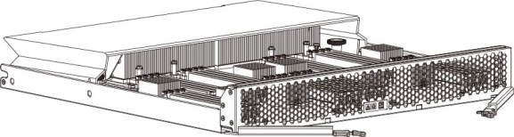
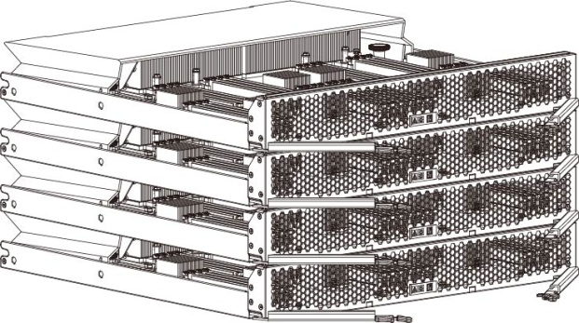
I980-G10 Technical highlight 1--hardware partitions
Easy to extend
  Buy single 4-way server if not enough budget ; later can buy computation model and mating parts to extend into 8-way server.
Flexible to use
  Free switch between 8-way and 2* 4-way to meet different needs of clients 'environments
﹢
Notes:
先讲整个IT行业的大背景

Slide 11
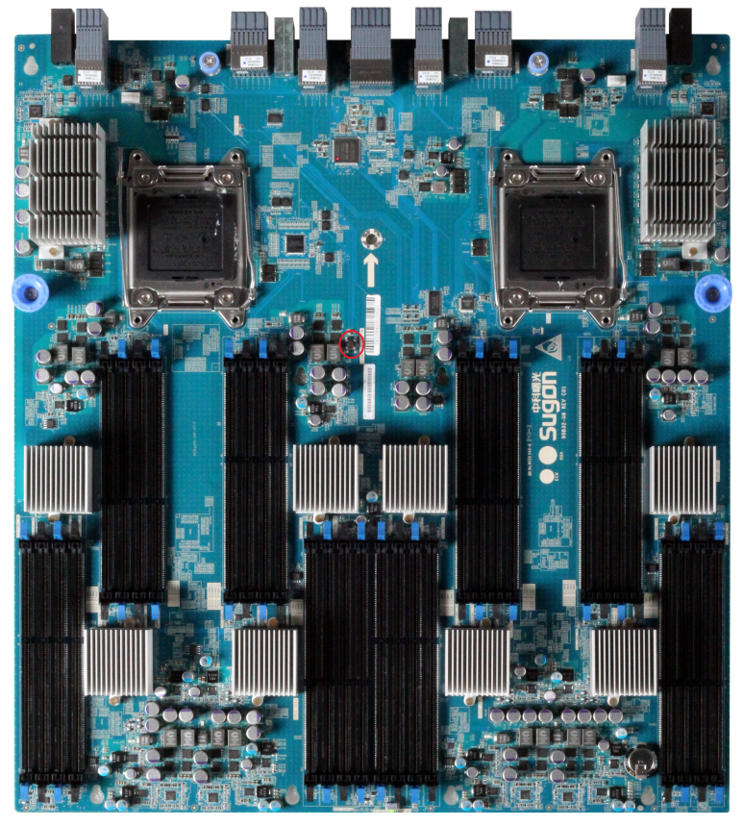
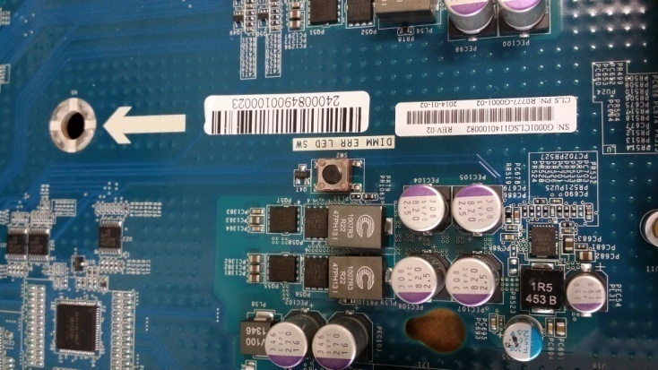
I980-G10 Technical highlight 2---
offline-optical diagnosis
Supercapacitor is concentrated on mainboard: if mainboard is cutoff, control the button ：
  LED light of faulty parts is on
  Fast to position the faulty parts
Higher efficiency in maintaining
  Protect client use to its greatest extent
Notes:
先讲整个IT行业的大背景

Slide 12
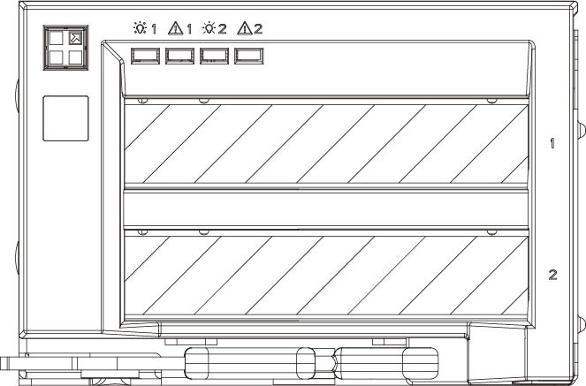
I980-G10 Technical highlight 3---PCI-E hot plug
PCIE hot plug-- meaningful function in this field
  IOE rear module and Modular design are essential requirements to the meaningful function--hot plug
  Design of powerful BIOS function provides sufficient condition for hot plug
Improve reliability of the system
  Some crucial and fragile parts such as network card and HBA card can be replaced
  Newly extended PCI-E easy to be added online makes the system easily extension
热插拔按键
Notes:
先讲整个IT行业的大背景

Slide 13
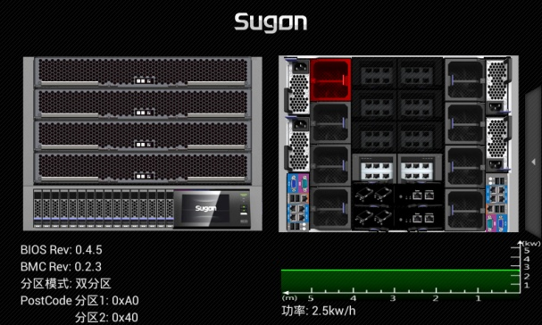
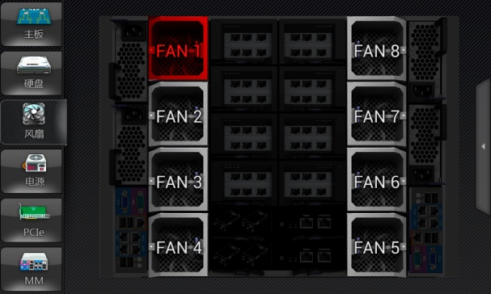
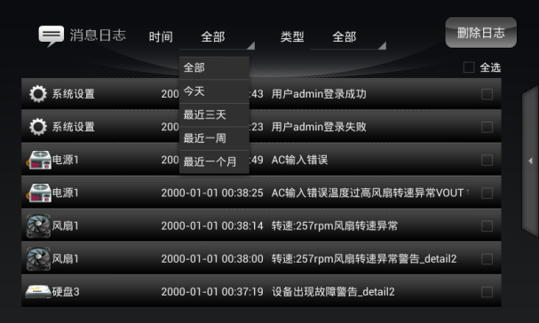


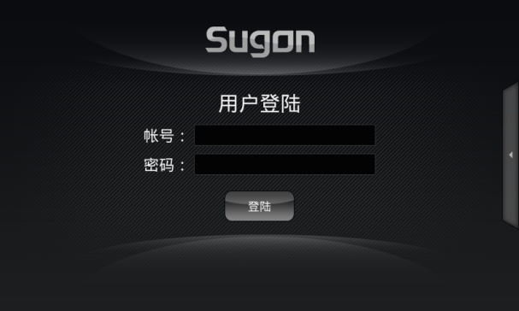
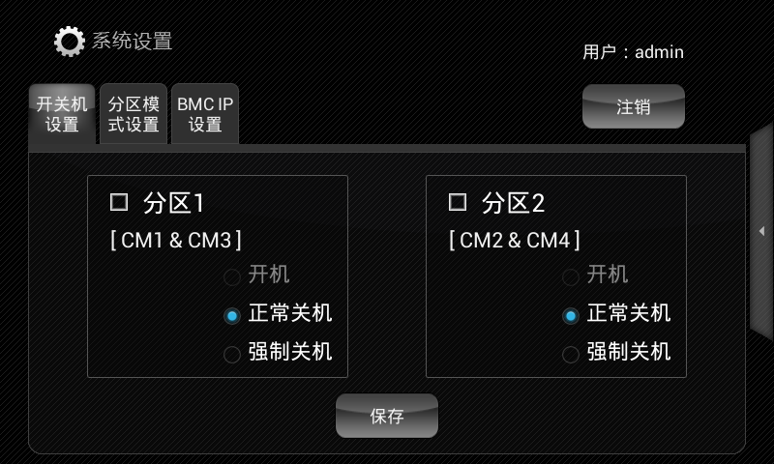
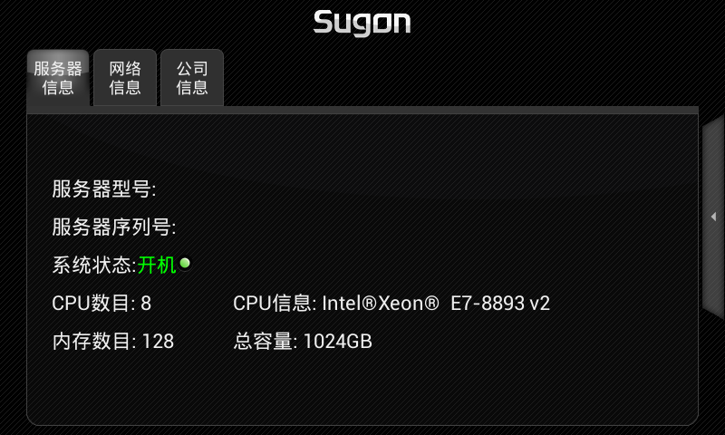
I980-G10 Technical highlight 4-- Touch Screen Monitoring
supervise in all dimensions
Permission
setting
failures easy to be positioned
A friendly interactive interface
A good user experience
Perfect and powerful monitor function
交互界面友好！
用户体验良好！
Accelerator setting, safe management, and rich information
Confirm and alarm setup
well documented logs
clear product information
Notes:
先讲整个IT行业的大背景

Slide 14

I980-G10 Technical highlight 5---Fast Video
the server boot can quickly brighten screen
post 80 code on the lower right of the screen is to know the self-checking progress, cooperate with the corresponding codes table and quickly find out the situation of the failure parts
Greatly improve the screen displaying speed when starting up
Notes:
先讲整个IT行业的大背景

Slide 15
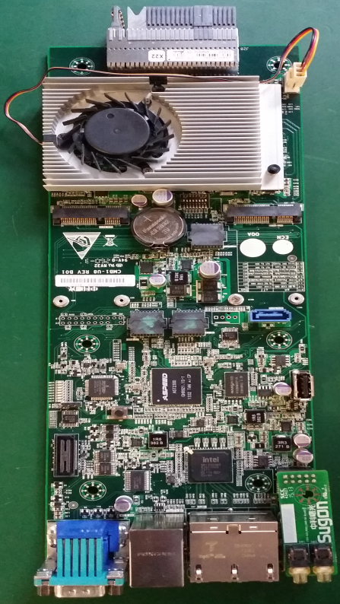
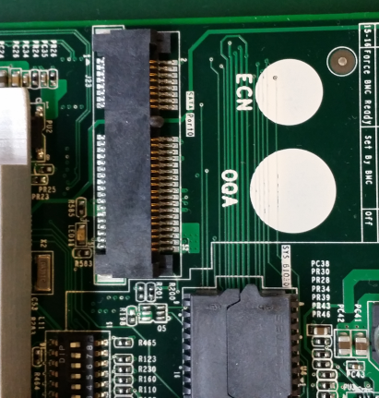
I980-G10 Highlight 6---mSATA interface
Southbridge management reserving mSATA interface can install 2 64GB/128GB SATA Flash disks to install and quickly start operating system
The rear 16 disks are used as storage module
Notes:
先讲整个IT行业的大背景

Slide 16

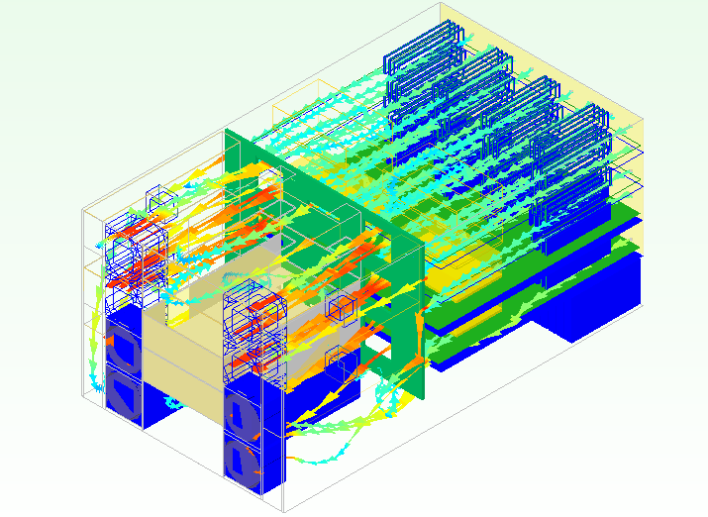
I980-G10 highlight 7---cooling poor and green energy-saving
Dust proof panel can improve systematic cleanness under harsh environments and enhance systematic reliability
All the parts comes to be modularization according to various functions
The CPU module can be installed through five-level orientation
The wind power pool, most optimization of fan power to flexibly allocate wind capacity with different configuration, provide unified thermal management and cooling management
Modeling the thermal management of vehicle engines
www.dcsimtech.com
提供统一热管理和冷却管理；
通过BMC的管理实现系统柔性设计和动态变化，服务器待机和日常工作状态的噪音降至40dB以下；
Notes:
先讲整个IT行业的大背景

Slide 17
Contents
1
Process and positioning of the product
2
Overview and features of the product
3
RAS and reliability of the product
4
Ecosystem and solution
Notes:
先讲整个IT行业的大背景

Slide 18
Stability and reliability—the inherent features of
Sugon servers
Compatibility lab, network lab, reliability lab, acoustic lab, large equipment lab, SI lab；
Over 5000 different tests to make sure the reliability from the original to the whole machine
The first one to develop high-speed signal test in this field；
Holding the high-end products，99.99% of which have the reliability structure design ability；
Comparable to reliability the design of RISC minicomputer；
Owning the largest sever development laboratories in China
high reliability in design ability of multiway-server over 10 years
The largest performances of high-end server using
The most rigorous testing process
First article qualification of normativity, trial-manufacture process in bulk；
Over 5000 test items；
56 RAS properties of design ability；
Applying for hundreds of patents of reliability design；
enterprise-class users are over 80% of all the shipments;
Millions of shipments such as bracket type, blade type and high-density server;
Stability and reliability— the inherent features of Sugon servers
Notes:
先讲整个IT行业的大背景

Slide 19
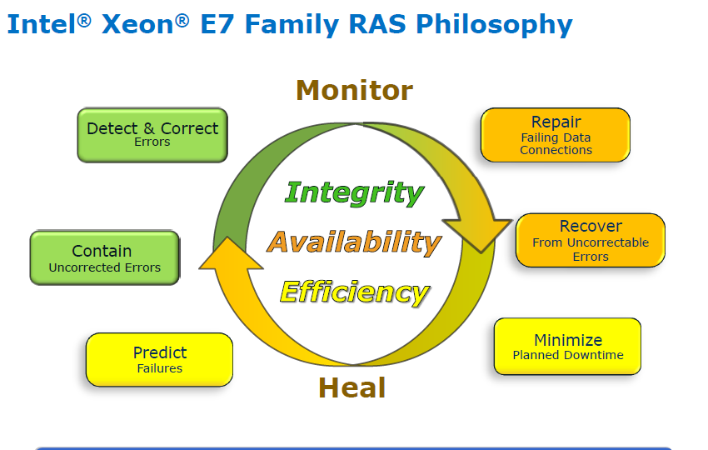
I980-G10 high reliability—RAS design idea
What is RAS？
Reliability Availability Serviceability
Data integrity+ Fault Tolerance+ High reliability in whole system
Make sure the longest continuous time in normal operation.
Reduce machine down time as short as possible
Notes:
先讲整个IT行业的大背景

Slide 20

I980-G10 High reliability– RAS feature
RAS types | Supporting quantities
Processor RAS | 6
Intel QPI RAS | 8
Memory RAS | 23
IIO/PCIE RAS | 8
System-level RAS | 11
Total number | 56
Reliability rate: 99.999%
powerful
monitoring
Remote IPMI management
Proximal monitor screen
software
design
hardware
design
Redundancy design in key parts
Modularization design
50+RAS design
Notes:
先讲整个IT行业的大背景

Slide 21
I980-G10 High reliability— software RAS
Error processing procedure management Four steps
Error-tolerance
1. Avoid error; 2. find bugs;
3. correct mistakes
Total care of system
Error management
4. Restrcucture
Applications
Bug fixes on application layer
operating system/virtual machine
Bug fixes on operation layer
Error management on operation layer
Bug fixes on Firmware hardware layer
FW (OEM/IBV/BMC)
Error management on Firmware hardware layer
Error signal and itspolling
Avoid error, find bugs and correct mistakes on hardware design layer.
Error Log
FW (Intel)
For example，
memory SDDC and DDDC
Silicon
For example, separation log of memory problem
Systematic reliability testifies the system operating time
manageability in system
Reduce machine down time as short as possible
Three links in error processing procedure：
Hardware, Firmware hardware and Software
Notes:
先讲整个IT行业的大背景

Slide 22


I980-G10 High reliability– Software RAS
Mirror-Memory Image
Sparing-Memory Spare
SDDC/DDDC+1-
Memory list/ Bi-particle fault rectification
Memory list/Bi-particle fault、1bit Error rectification
Lock Step fault-tolerant technique
Failover CPU eliminating mechanism
Failover CPU core eliminating mechanism
Isolation mechanism on wrong data
Enhanced framework of machine check
Executive/Non-Executive path MCA recovery mechanism
Data protection is in every link of data transmission to greatly improve reliability and availability of the machine
CPU
Memory
IO
System
correct mistakes reporting mechanism
CPU Online Expansion
CPU Board Hot-Socking（need OS to support）
QPI bus correction and report
PCIe device Hot-Socking
PCIe fault correction mechanism
PCIe advanced fault reporting mechanism
Notes:
先讲整个IT行业的大背景

Slide 23
I980-G10 High reliability– Monitoring management
All-around parts monitoring function
Powerful recording of fault log and inquiry function
All the failure parts in BMC monitoring scale can be recorded in log of rich information such as failure time, failure type and failure location. It can greatly shorten the time that needs maintenance worker to check and improve maintenance inefficiency.
High Manageability
It can realize remove startup and shutdown, iKVM, virtual media, BIOS online update and BMC
Information richness
It contains computer’s serial, detailed configuration, BIOS type、BMC type
It can monitor these parts such as mainboard, CPU, memory, hardware, fan, power supply, RAID card, external PCI expensive card and Onboard LAN.
Notes:
先讲整个IT行业的大背景

Slide 24

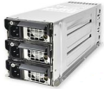

I980-G10 High reliability– Hardware RAS
Redundancy
Design
Cooling system redundancy
Modularization for whole design
Storage system redundancy
Power system redundancy
Memory redundancy
System time redundancy
ＣＰＵ
Hot plug design of board module
Failure CPU can be changed online
！
Fans
8 Hot plugs、redundant and systematic fans
Make sure stability and reliability of system operating
！
Power
Optional 4 power modules:2+1, 3+1, 2+2 redundancy
Improve system availability
！
Hot-plug Design
CPU board
Hard disk
PCIE
insert card
Power supply
Fans
Management module
Disk configuration RAID controller supporting RAID1,5, and 6
Mostly realize data security and improve reliability
Hard disk
Ｃ：drive
Ｄ：drive
Monitor screen
Timely to monitor the server status
Clearly to find the fault warning
Accurate to locate the failureproblem
Notes:
先讲整个IT行业的大背景

Slide 25
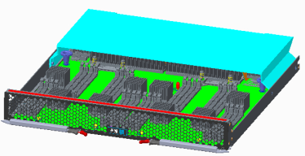
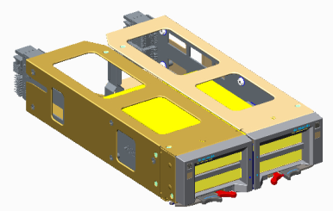
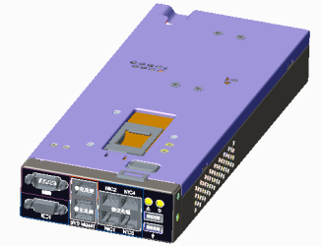
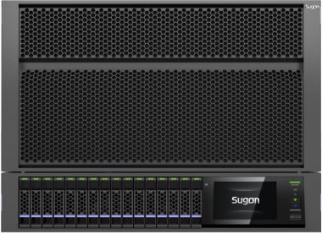
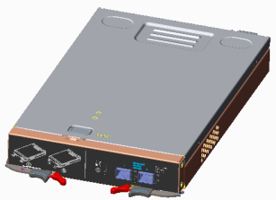
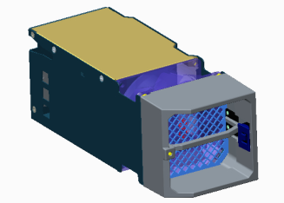
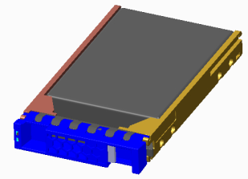
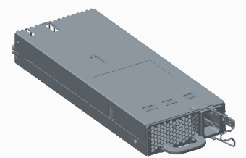
Modularization design，install without tool and maintenance without unpack
Supporting install and dismantlement without tool; every module chassis can be pluggable front and rear; maintenance without unpack
CPU module
IOE module
I980-G10
10-gigabit module
Management
module
Fan module
2.5’disk module
PSU power
Notes:
先讲整个IT行业的大背景

Slide 26
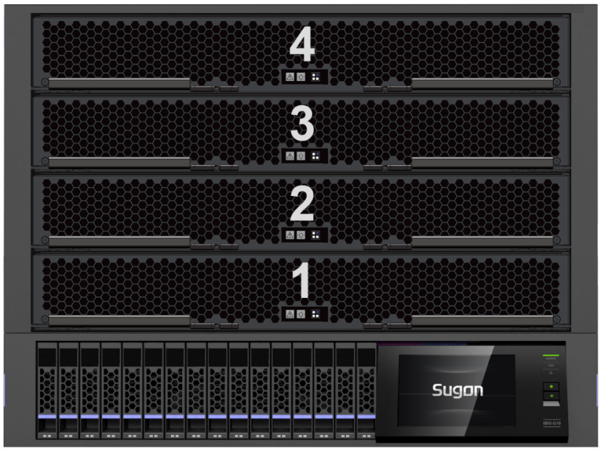
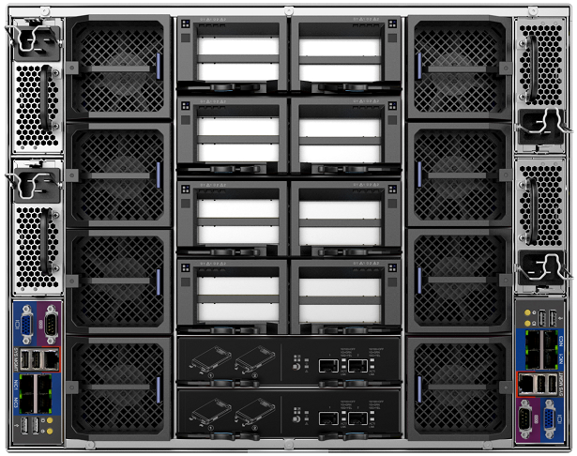
I980-G10 hardware partitioning technique
Flexible application
  8-way and 4-way can switch freely to meet the different clients’ application needs;
Some parts are common
  Power supply modules together low the consumption
  Fans together low the consumption and noise
  Monitor modules are common to manage lowing the costs
Partitioning 1
Partitioning 2
Core parts are all independent
  CPU module， IOE module，10-gigabit module， storage module are all independent and can be used bifurcated
Notes:
先讲整个IT行业的大背景

Slide 27
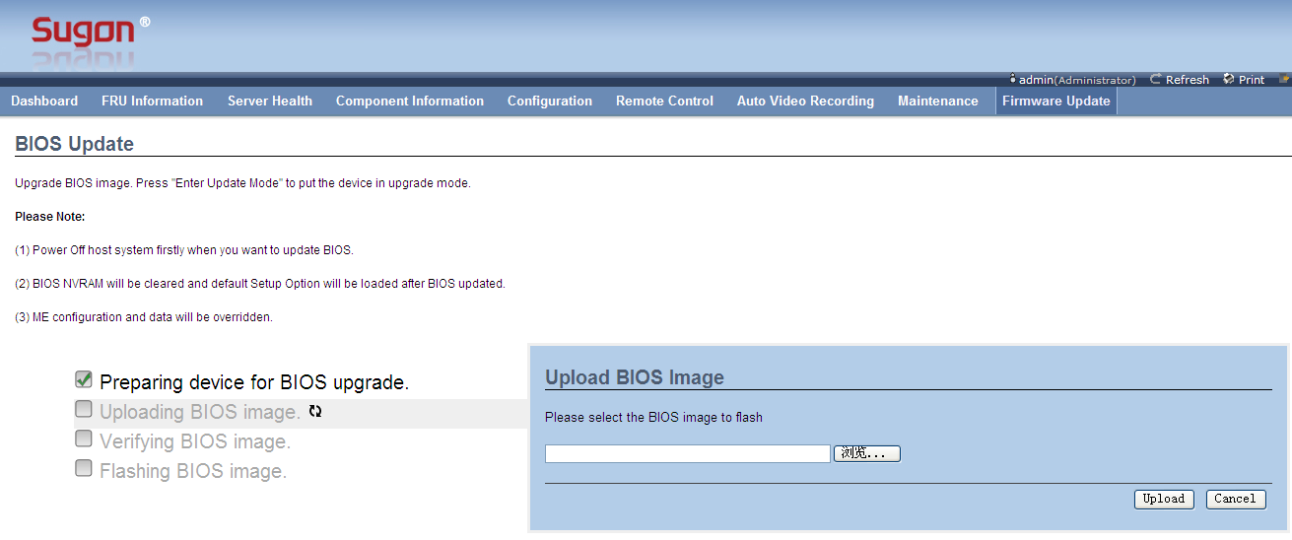
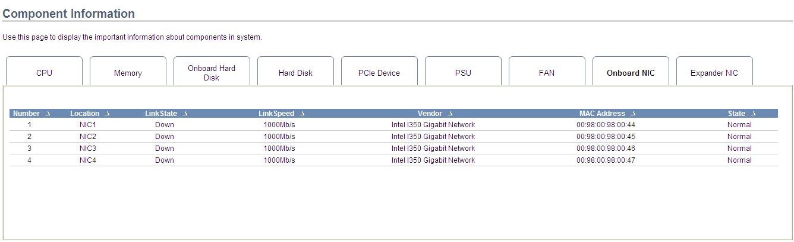
Unified maintenance and management
  Sugon self-develop management module (BMC) supports independent management interfaces such as IPMI2.0 and SNMP; supports SOL, CLI and KVM over IP; supports the remote BIOS/Firmware update;
  Easy to locate parts and to diagnose the failure in the system;
  BIOS FW can be remote updated through BMC Web providing convenience in human-oriented update strategy;
  The first company has realized to monitor the key information of network cards through BMC. The key information includes manufacturer, type, speed, link state, MAC address and correspondence between MAC and NIC.
Notes:
先讲整个IT行业的大背景

Slide 28
Contents
1
Process and positioning of the product
2
Overview and features of the product
3
RAS and reliability of the product
4
Ecosystem and solution
Notes:
先讲整个IT行业的大背景

Slide 29
I980-G10 Eco-environmental construction— operating system
Good compatibility
Windows2008
Windows2012
Windows8
Suse 11sp2 64bit
Suse 11sp3 64bit
Suse 11sp3 64bit（with xeon）
RHEL 6U4 64bit
RHEL 6U3 64bit
RHEL 5U9 64bit
RHEL 5U8 64bit
Citrix XenServer 6.1
Vmware ESXi 5.0U1
Vmware 5.1U1
Notes:
先讲整个IT行业的大背景

Slide 30
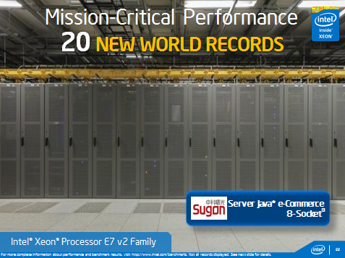
I980-G10 Excellent performance
8 E7-8890V2 processors
SPECjbb2013
  Max-jops 214961
  Critcal-jops 23058
SPEC-CPU2006
  SPECint(R)_rate_base2006 4200
  SPECint_rate2006 4350
  SPECfp(R)_rate_base2006 2860
  SPECfp_rate2006
Memory space：1TB
3x 480G RAID 0
SPECjbb performance testing holds the first place in the world！
Notes:
先讲整个IT行业的大背景

Slide 31



















Mature eco-environment
L5-application
L4-middleware
L3-database
L2-virtualization
L1-operating system
L0-hardware platform
Notes:
先讲整个IT行业的大背景

